Slide 1
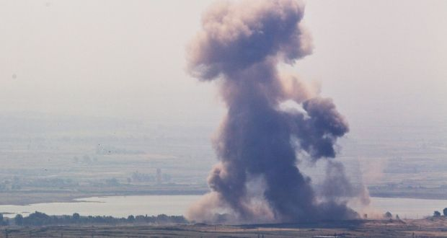
ANALYZING TEXT
OF CONFLICT
REPORTS

Slide 2
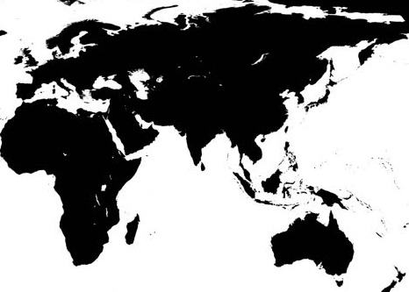

RECAP: THE DATA
disaggregated conflict analysis and crisis mapping project.
Source @ acleddata.com
Notes:
(etc description on this)

Slide 3
RECAP: THE DATA
Europe | 26315 | 5.17
Middle East | 134805 | 26.48
Eastern Africa | 62995 | 12.37
Northern Africa | 42195 | 8.29
Western Africa | 31515 | 6.19
Middle Africa | 25195 | 4.95
Southern Africa | 19085 | 3.75
South-Eastern Asia | 25502 | 5.01
Southern Asia | 141550 | 27.8
5%
26%
33%
36%
Source @ acleddata.com
Notes:
(Stats about data)

Slide 4
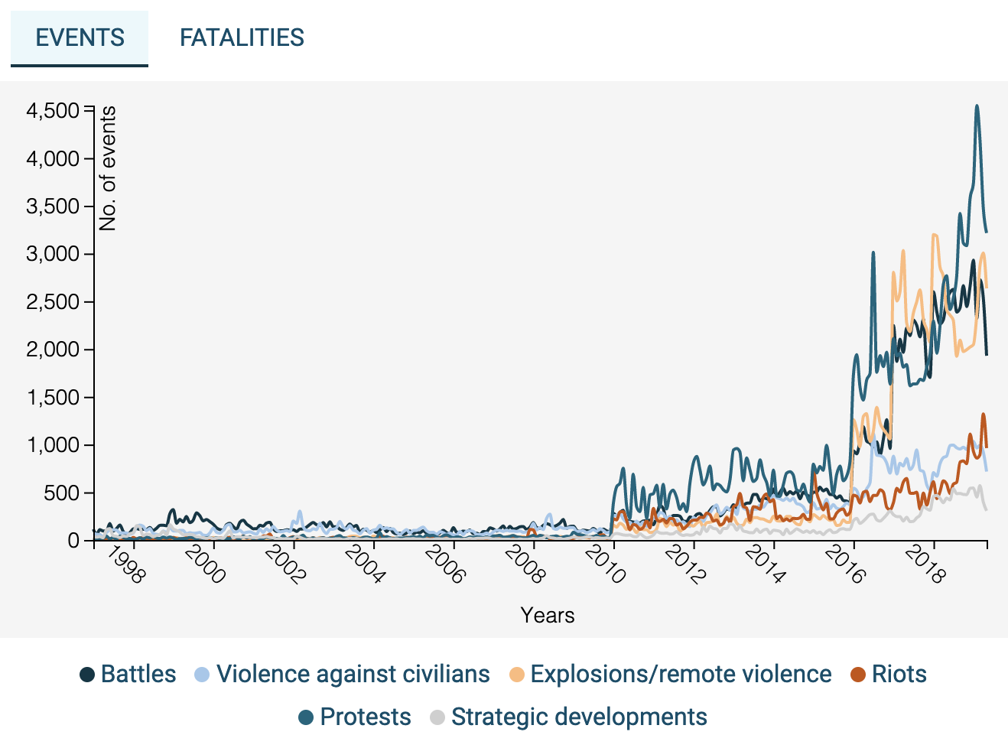
RECAP: THE DATA
Africa
Asia
Europe
Middle East
Source @ acleddata.com
Notes:
(Stats about data)

Slide 5
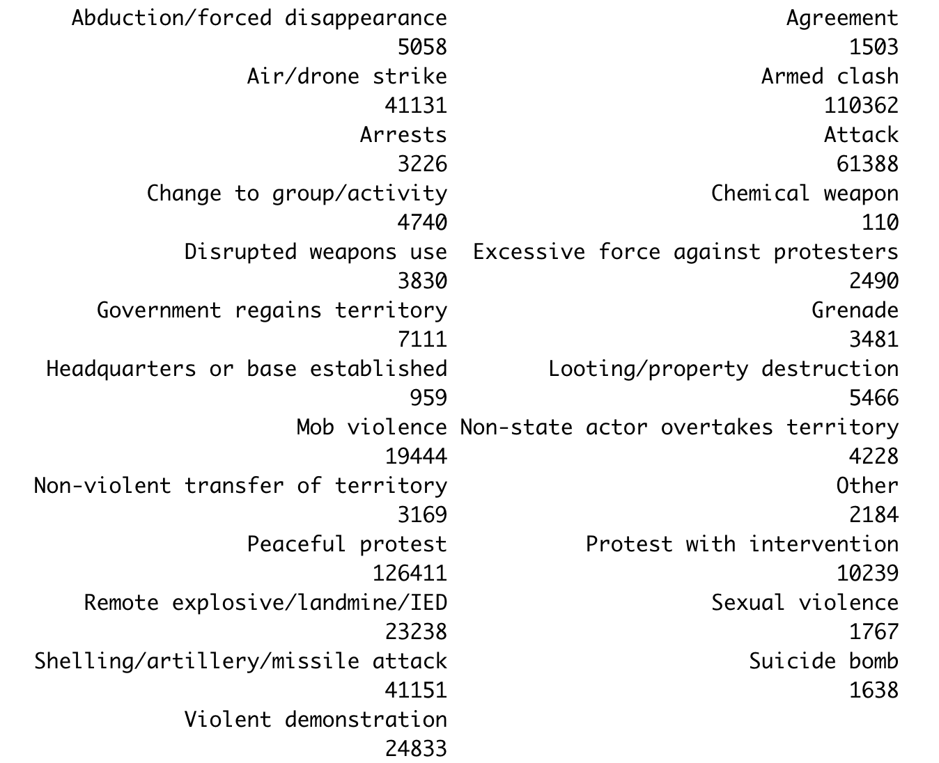
RECAP: TYPES OF EVENTS
Source @ acleddata.com
Notes:
(Stats about data)

Slide 6
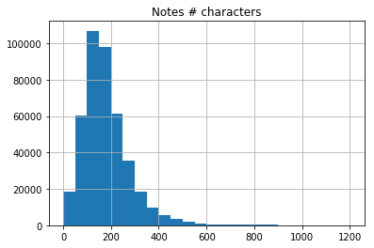
NOTES examples:
“26th Feb 2001- BBC Mon-Large military offensive all over the country sees 9 soldiers and 6 GIA killed” (101 characters)
“A 40-year-old repentant who answered to the name of Hamid Doghman was assassinated this past Tuesday 4 March at about 2000 hours not far from downtown Zemmouri 16 kilometres east of Boumerdes by a militant group made up of between four and six elements. The attack targeted this ex-Islamist who had signed his repentance in August 1995.”
RECAP: THE TEXT
509,157 Observations
Common pre-processing: Keeping those observations with > 100 characters
Source @ acleddata.com
Notes:
(Pre-processing)

Slide 7
GOAL 1:
Identify contesting parties
GOAL 2:
Relationship extraction
GOAL 3:
Topic analysis extraction

Slide 8
GOAL 1:
Identify contesting parties
GOAL 2:
Relationship extraction
GOAL 3:
Topic analysis extraction

Slide 9
ACTOR1 | INTER1 | ACTOR2 | INTER2 | INTERACTION | NOTES
GIA: Armed Islamic Group | Rebel Groups (2) | Military Forces of Algeria (1999-) | State Forces (1) | 12 | 26th Feb 2001- BBC Mon-Large military offensive all over the country sees 9 soldiers and 6 GIA killed
Unidentified Armed Group (Algeria) | Political Militias (3) | Civilians (Algeria) | Civilians (7) | 37 | A 40-year-old repentant who answered to the name of Hamid Doghman was assassinated this past Tuesday 4 March at ...
Initially:
Predict specific actors (e.g. Syria’s Military, Boko Haram, village)
Use SpaCy or Stanford NER to perform regular Name Entity Recognition and POS inputs.
Predict “actor1” and “actor2”.
Use neural networks
Challenges:
Difficulty tagging organizations accurately.
Actor labels often incorporated more information than notes.
Complexity of predicting two variables (actors) at the same time
GOAL 1:
Identify contesting parties

Slide 10
ACTOR1 | INTER1 | ACTOR2 | INTER2 | INTERACTION | NOTES
GIA: Armed Islamic Group | Rebel Groups (2) | Military Forces of Algeria (1999-) | State Forces (1) | 12 | 26th Feb 2001- BBC Mon-Large military offensive all over the country sees 9 soldiers and 6 GIA killed
Unidentified Armed Group (Algeria) | Political Militias (3) | Civilians (Algeria) | Civilians (7) | 37 | A 40-year-old repentant who answered to the name of Hamid Doghman was assassinated this past Tuesday 4 March at ...
New approach:
Predict “Interaction” (41 categories) using a Neural Network with 2 hidden layers (size 128 and 100).
Use pre-trained SpaCy word2vec embeddings as input. Provides vector of 300 dimensions for complete sentences.
GOAL 1:
Identify contesting parties

Slide 11
10- SOLE MILITARY ACTION | 26- REBELS VERSUS PROTESTERS | 47- COMMUNAL MILITIA VERSUS CIVILIANS
11- MILITARY VERSUS MILITARY | 27- REBELS VERSUS CIVILIANS | 48- COMMUNAL MILITIA VERSUS OTHER
12- MILITARY VERSUS REBELS | 28- REBELS VERSUS OTHERS | 50- SOLE RIOTER ACTION
13- MILITARY VERSUS POLITICAL MILITIA | 30- SOLE POLITICAL MILITIA ACTION | 55- RIOTERS VERSUS RIOTERS
14- MILITARY VERSUS COMMUNAL MILITIA | 33- POLITICAL MILITIA VERSUS POLITICAL MILITIA | 56- RIOTERS VERSUS PROTESTERS
15- MILITARY VERSUS RIOTERS | 34- POLITICAL MILITIA VERSUS COMMUNAL MILITIA | 57- RIOTERS VERSUS CIVILIANS
16- MILITARY VERSUS PROTESTERS | 35- POLITICAL MILITIA VERSUS RIOTERS | 58- RIOTERS VERSUS OTHERS
17- MILITARY VERSUS CIVILIANS | 36- POLITICAL MILITIA VERSUS PROTESTERS | 60- SOLE PROTESTER ACTION
18- MILITARY VERSUS OTHER | 37- POLITICAL MILITIA VERSUS CIVILIANS | 66- PROTESTERS VERSUS PROTESTERS
20- SOLE REBEL ACTION | 38- POLITICAL MILITIA VERSUS OTHERS | 67- PROTESTERS VERSUS CIVILIANS
22- REBELS VERSUS REBELS | 40- SOLE COMMUNAL MILITIA ACTION | 68- PROTESTERS VERSUS OTHER
23- REBELS VERSUS POLITICAL MILIITA | 44- COMMUNAL MILITIA VERSUS COMMUNAL MILITIA | 78- OTHER ACTOR VERSUS CIVILIANS
24- REBELS VERSUS COMMUNAL MILITIA | 45- COMMUNAL MILITIA VERSUS RIOTERS | 80- SOLE OTHER ACTION
25- REBELS VERSUS RIOTERS | 46- COMMUNAL MILITIA VERSUS PROTESTERS
GOAL 1:
Identify contesting parties

Slide 12
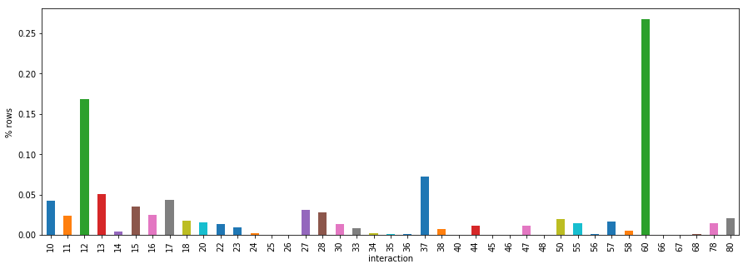

Slide 13
Pipeline:
Pre-processing:
drop notes with <100 characters and three strange codes
Split data: 75% oldest news training (~310K), random 12.5% split test and validation (~52K each)
Train Neural network:
Apply SpaCy word2vec to each notes
2 epochs through entire training data
Learning rate = 0.001; Adam optimizer
Each 80,000 observations check in validation and save best model
Use a simple logistic regression “neural network” as baseline (HW1)
GOAL 1:
Identify contesting parties

Slide 14
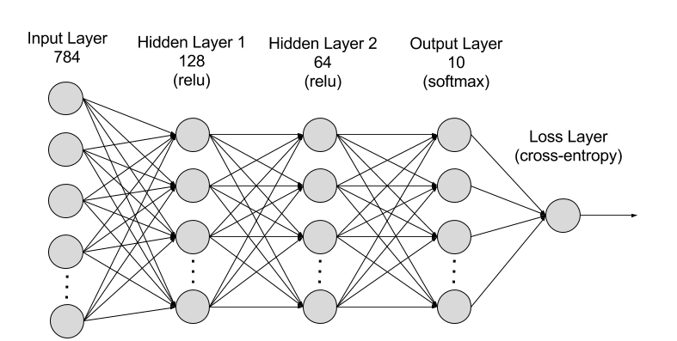
300
100
41
(NNNL)
(SpaCy word2vec)

Slide 15
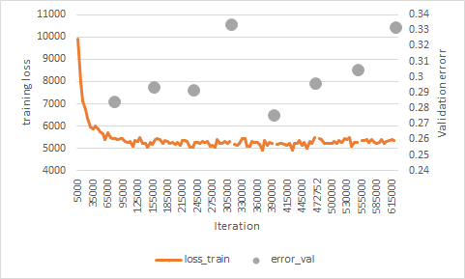
Results:
Test error:
0.2774
BL model:
0.4911

Slide 16
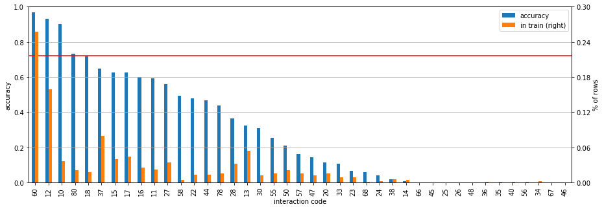
Top 5:
60- SOLE PROTESTER ACTION
12- MILITARY VERSUS REBELS
10- SOLE MILITARY ACTION
80- SOLE OTHER ACTION
18- MILITARY VERSUS OTHER
While number of training observations was important for accuracy, there is more happening.
Words or actions specific to categories: “Coalitions”, “Protestors”, “Established base”
GOAL 1:
Identify contesting parties

Slide 17
60- SOLE PROTESTER ACTION
“A protest was staged in Colombo on 26 October 2017 demanding the release of IUSF activists and other students in remand custody.”
12- MILITARY VERSUS REBELS
“MoD reports Afghan army conducted military operations across 17 provinces; killing 36 suspected Taliban militants. Fatalities split across 15 provinces, with some specific events listed in article. 21 fatalities coded in this series while 15 previously coded in other events. 15 Events in total as operations, with Nangarhar and Kunduz were already coded separately.”
10- SOLE MILITARY ACTION
“Military forces established an operational base in Kazimiya, in order to better control this area on Lake Tanganyika.”
80- SOLE OTHER ACTION
“The Saudi-led coalition carried out three air raids on the Atias mountain and two air raids on the Nashr area in the Sirwah district, Marib governorate. No casualties were reported but private property was damaged.”
18- MILITARY VERSUS OTHER
“Pro-Houthi forces claim to have shelled Saudi soldiers in Raqabat-sudais and Makhroq, Najran. No injuries reported.”

Slide 18
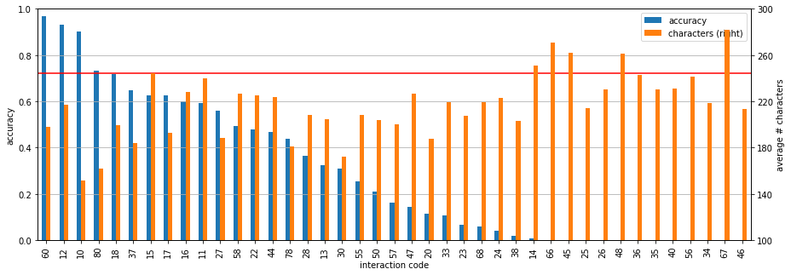
# characters doesn’t seem to help that much
Regression of 'correct_pred ~ C(interaction_code) + C(year) + characters' shows each additional character decreases accuracy in 0.03 pp.
News from 2018 also had higher accuracy.
Notes and labels were not super clean.

Slide 19
GOAL 1:
Identify contesting parties
GOAL 2:
Identify relationship between parties
GOAL 3:
Topic analysis extraction

Slide 20
Pre-processing
LSTM
Bidirectional LSTM
Caveats
Ongoing work
GOAL 2:
Identify relationship between parties

Slide 21
Initial proposal: Relationship extraction
A attacks B or B attacks A
But all of our cases where we know directionality go in the same direction
Implementation: Multi Classification task
What is the action that A inflicts on B
Classes: 333 specific kinds of attacks
Pre-processing
LSTM
Bidirectional LSTM
Caveats
Ongoing work

Slide 22
Pre-processing
LSTM
Bidirectional LSTM
Caveats
Ongoing work
Subset data to cases where we knew who the aggressor is:
Attacks on civilians
Use SpaCy POS tagger to find all verbs that appear in the corpus
Manually identify verbs related to violent action; label cases according to that list.
Update string
Challenge: No labelled data.
GOAL 2:
Identify relationship between parties

Slide 23
Pre-processing
LSTM
Bidirectional LSTM
Caveats
Ongoing work
Subset data to cases where we knew who the aggressor is:
Attacks on civilians
Use SpaCy POS tagger to find all verbs that appear in the corpus
Manually identify verbs related to violent action; label cases according to that list.
Update string
‘two VICTIM injured while farming in a northern village by AGGRESSOR’
‘AGGRESSOR injured after having shelled a VICTIM ’
Challenge: No labelled data.
GOAL 2:
Identify relationship between parties

Slide 24
Pre-processing
LSTM
Bidirectional LSTM
Caveats
Ongoing work
4. Identify all the ways in which aggressors are mentioned
Ex: ‘AQAP: Al Qaeda in the Arabian Peninsula’
[‘AQAP’, ‘Al Qaeda’, ‘AQAP: Al Qaeda in the Arabian Peninsula’]
Ex: ‘Unidentified Armed Forces’
[‘Unidentified Armed Forces’ , ‘Unidentified Armed Group’, ‘Unidentified Forces’, (...)]
1238 categories in the end
5. Identify all the ways in which victims are mentioned
[‘civilians’, ‘citizens’, ‘families’, ‘villagers’, ...]
Challenge: No labelled data.
GOAL 2:
Identify relationship between parties

Slide 25
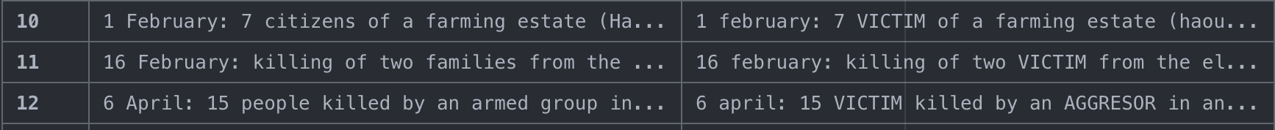
Pre-processing
LSTM
Bidirectional LSTM
Caveats
Ongoing work
4. Identify all ways in which aggressors are mentioned
Ex: ‘AQAP: Al Qaeda in the Arabian Peninsula’
[‘AQAP’, ‘Al Qaeda’, ‘AQAP: Al Qaeda in the Arabian Peninsula’]
Ex: ‘Unidentified Armed Forces’
[‘Unidentified Armed Forces’ , ‘Unidentified Armed Group’, ‘Unidentified Forces’, (...)]
5. Identify all ways in which victims are mentioned
[‘civilians’, ‘citizens’, ‘families’, ‘villagers’, ...]
6. Update string
Total Data
> 100 characters
We can identify directionality
Have ‘victim’ & ‘aggressor’ strings
Have ‘victim’ OR ‘aggressor’ strings
GOAL 2:
Identify relationship between parties
509,157
415,462
50,671
8,294
34,556
Notes:
Try it with both & and OR, if there is time.

Slide 26
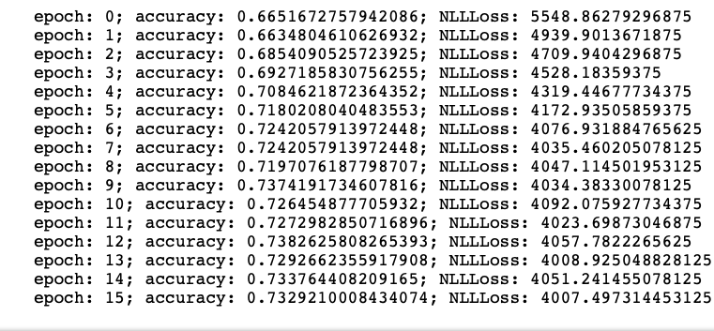
Recurrent Neural Network approach
Results with:
Optimization: Adam
Adjusting LR for every iteration
Default alpha
Loss:
Negative Logistic Log Likelihood
N_epochs:
15.
HidDim:
30
Embeddings:
10
Pre-processing
LSTM
Bidirectional LSTM
Caveats
Ongoing work
Best model evaluated on test:
73.42%

Slide 27
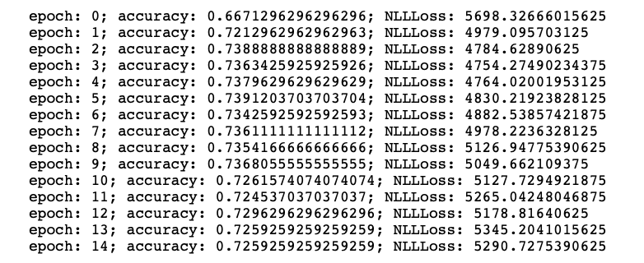
Recurrent Neural Network approach
Results with:
Optimization: Adam
Adjusting LR for every iteration
Default alpha
Loss:
Negative Logistic Log Likelihood
N_epochs:
15.
HidDim:
30
Embeddings:
10
Pre-processing
LSTM
Bidirectional LSTM
Caveats
Ongoing work
Best model evaluated on test:
74.35%

Slide 28
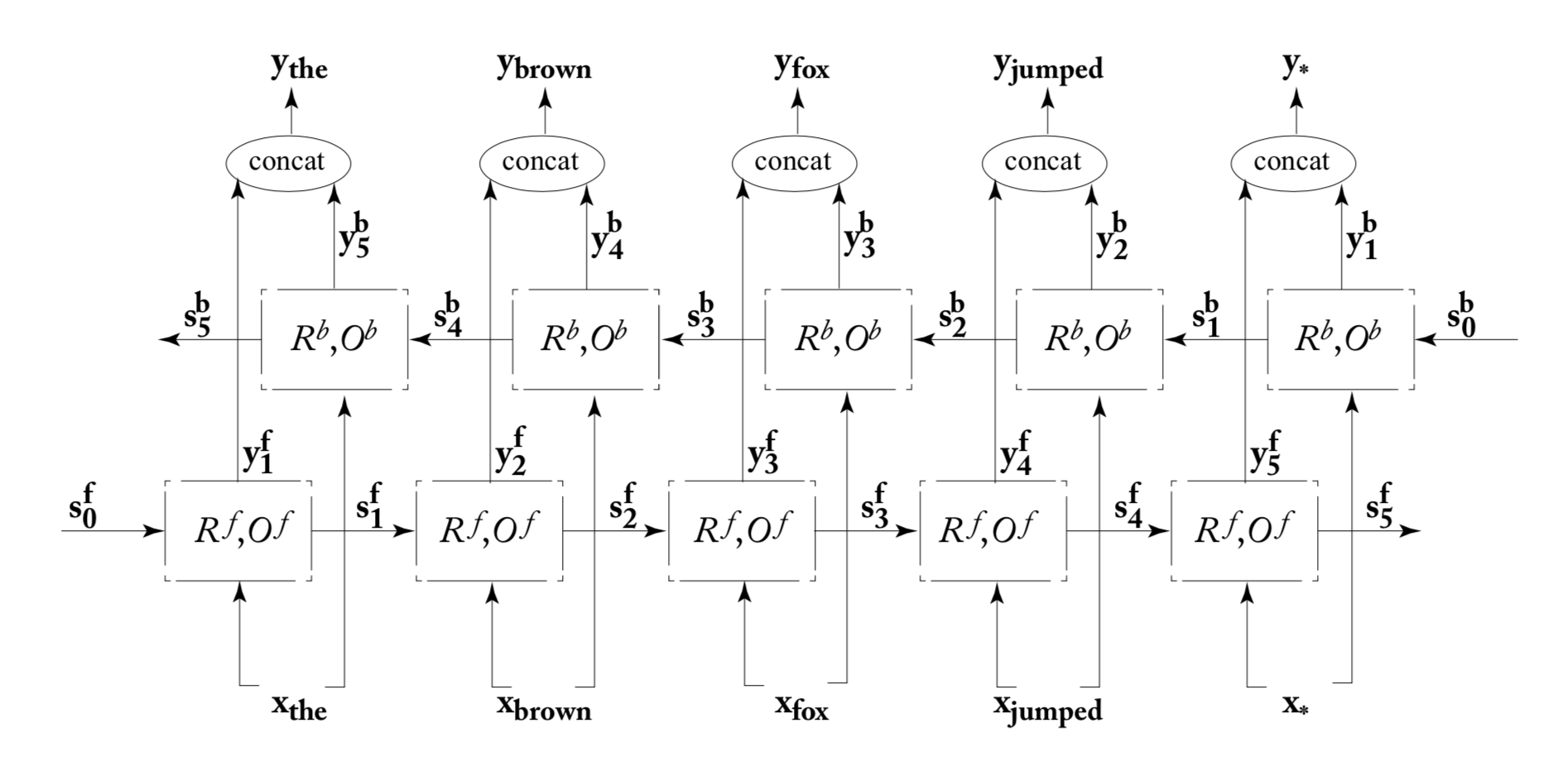
Neural Network Methods for Natural Language Processing
Pre-processing
LSTM
Bidirectional LSTM
Caveats
Ongoing work
Accuracy from test
LSTM 73.42%
Bi-dir 74.35%
GOAL 2:
Identify relationship between parties
Notes:
We will check code to see if its actually taking into account both “bi-directions”.

Slide 29
Pre-processing
LSTM
Bidirectional LSTM
Caveats
Ongoing work
Tune both approaches changing
Optimizer
Learning Rate
Alpha
Weight decay
See if our predictions are balanced across:
Years
Countries / regions
Types of conflicts
GOAL 2:
Identify relationship between parties

Slide 30
GOAL 1:
Identify contesting parties
GOAL 2:
Identify contesting parties
GOAL 3:
Topic analysis extraction

Slide 31
GOAL 1:
Identify contesting parties
GOAL 2:
Identify relationship between parties
GOAL 3:
Topic analysis extraction

Slide 32
Goals
Recent Literature
Pre-processing
LDA
Visualizations
Ongoing/future work
Motivation
Extract underlying themes & topics in the ACLED data
Use these to identify similarities in conflicts around the world
Understand distributions by geography & trends
GOAL 3:
Topic analysis extraction

Slide 33
Goals
Recent Literature
Pre-processing
LDA
Visualizations
Ongoing/future work
Tarik Altuncu, M et al. “Content-driven, unsupervised clustering of news articles through multiscale graph partitioning.”, Data Science, Journalism & Media workshop (Aug 2018)
Unsupervised approach for “hard clustering”
Doc2Vec embeddings trained on 5M+ Wikipedia articles
Generate a Similarity Graph (Gs) using pairwise cosine similarity between documents in the training set
Create a Min Spanning Tree with MST-kNN
Markov Stability used to define hard clusters based on partitions extracted using the MST
GOAL 3:
Topic analysis extraction
⇒ Really useful for automated clustering for given no. of topics
⇒ Bit of an overkill for our project

Slide 34
Goals
Recent Literature
Pre-processing
LDA
Visualizations
Ongoing/future work
We used pre-trained Word2Vec embeddings available with spaCy (en_core_web_md, en_core_web_sm) - each with 300 dimensions
We work with the full dataset, not filtering out anything since Topic Modeling is inherently exploratory; additional runs ongoing with notes of length 100+ characters
All conflict notes are tokenized by lemmatizing the words, ignoring the standard stopwords, and removing any pronouns after POS-tagging
First set of runs are essentially Bag-of-Words with unigrams; second set of runs (ongoing) on bi-grams
GOAL 3:
Topic analysis extraction

Slide 35
Goals
Recent Literature
Pre-processing
LDA
Visualizations
Ongoing/future work
We used Latent Dirichlet Allocation (LDA) for the Topic Modeling → most common, easiest to implement method for ‘soft clustering’
LDA is very similar to a Bag-of-Words Classifier, but works with inherent frequency distributions instead of optimizing against a target classification
Based on a given ‘number of topics’ every conflict note is mapped to each topic through a vocabulary length ‘items’. A sparse matrix (509,157 X 39,799) is then reduced to a denser matrix to assign topic distribution for each conflict note → kind of like training an ‘embedding’ in itself?
GOAL 3:
Topic analysis extraction
⇒ Unsupervised approach → no way to assess the model
⇒ Manual review of topics required after each full run

Slide 36
Goals
Recent Literature
Pre-processing
LDA
Visualizations
Ongoing/future work
Visualizations hosted on GitHub pages
3 topics | count | 2 iter
3 topics | count | 5 iter
3 topics | tfidf | 2 iter
5 topics | count | 2 iter
5 topics | tfidf | 2 iter
7 topics | count | 2 iter
7 topics | tfidf | 2 iter
10 topics | count | 2 iter
10 topics | tfidf | 2 iter
3 Topics (count) → spontaneity & participation
Civilian Unrest | Two-sided clash | Single Attack
5 Topics (tfidf) → strategized & ??
Civilian Unrest / Protest
Civil War Attack
Quantified Airstrikes / Raids
Terrorist Attack
??
7 Topics (tfidf)
→ topics are well-defined but dimensions are not
→ geographical factors visible
GOAL 3:
Topic analysis extraction
⇒ Increasing iterations → no significant impact
⇒ Raw Count & TFIDF give vastly different topic extracts

Slide 37
Goals
Recent Literature
Pre-processing
LDA
Visualizations
Ongoing/future work
LDA provides p(Topic | Conflict Note) → no objective way to assign one topic for each document
We would like to analyze the geographical distribution of Topics & year-on-year trends
Compare against ‘event type’ & ‘sub-event type’ provided by the researchers, as also against the ‘interaction’ labels & Aggresor ←→ Victim relations extracted
GOAL 3:
Topic analysis extraction
⇒ Simultaneously we want to switch to Continuous BoW
⇒ Using Custom Word Embeddings from Relation Extraction

